Slide 1
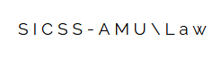
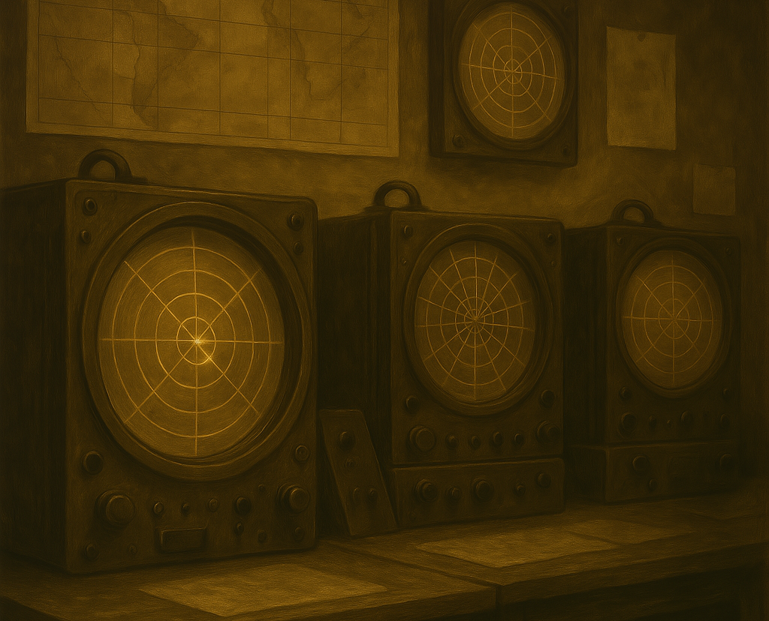
The Origins & fundamentals of Signal Detection Theory
From Radar Screens to Human Judgment
Mikołaj Wieczór, M.A.
Faculty of Psychology and Cognitive Science, AMU Poznan
Notes:
UWAGA:
Aby zmienić obraz na tym slajdzie, zaznacz obraz i usuń go. Następnie kliknij ikonę Obrazy w symbolu zastępczym,aby wstawić swój własny obraz.

Slide 2

The radar problem
It’s the middle of WWII. A British radar operator stares at a glowing screen filled with static and weak blips. Somewhere in that noise could be a German plane. But not every blip is real. Some are false echoes. Some signals are just strong enough to be real — or maybe not. The question becomes:
“Do I report an incoming aircraft, or not?”

Slide 3
What Is the Challenge?
Incomplete, noisy information
Unclear signals, uncertainty
High stakes: national security, lives of the civilians and troops
Uncertainty in „everyday life”: strange noise at night, suspicious e-mail, vague memory…

Slide 4


Signal vs. noise
Signal
(German plane, tumor, perpetrator, anything meaningful to us)
Noise
(just a big cloud, unclear CT image, innocent suspect, background randomness)

Slide 5
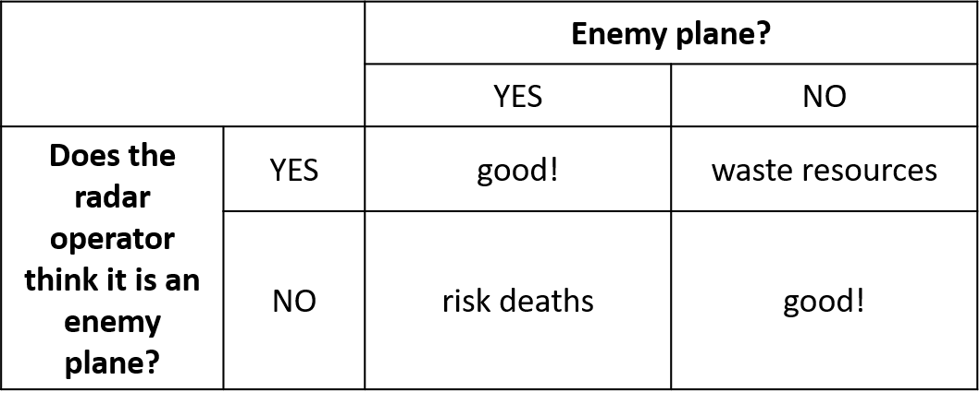
So, what to decide?
Decision is binary (Yes/No, Plane/No plane)
It always has 4 possible outcomes:

Slide 6
Outcomes in SDT
Operator: | Plane (Signal) | No Plane (Noise)
Said “Plane” | ✅ Hit | ❌ False Alarm
Said “No plane” | ❌ Miss | ✅ Correct Rejection

Slide 7
Why These Outcomes Matter
In law and medicine (as in other fields), correct and incorrect judgments have big consequences:
A real culprit goes to prison (good!) – hit
Innocent person is convicted (very bad!) – false alarm
Perpetrator is relesaed (also bad!) – miss
A possibly malignant tumor is detected and operated – hit
Operated tumor turns out to be non-lethal – false alarm
Tumor that should be operated now is left for observation - miss

Slide 8
Understanding Hit Rate & False Alarm Rate
✅ Hit Rate (HR)
Proportion of signal-present trials where the observer correctly says “Yes, signal!”
Formula: Hit Rate = Hits / (Hits + Misses)
Example:
40 trials with a signal
Observer says “Yes” 32 times when the signal was present → Hit Rate = 32 / 40 = 0.80
🚫 False Alarm Rate (FAR)
Proportion of signal-absent trials where the observer incorrectly says “Yes, signal!”
Formula: False Alarm Rate = False Alarms / (False Alarms + Correct Rejections)
Example:
60 trials with no signal
Observer says “Yes” 12 times when no signal was present → False Alarm Rate = 12 / 60 = 0.20
Important! These measures can be compared, regardless the proportion of signal-present to signal-absent trials, and number of all trials

Slide 9
Signal detection
What do we need to know?
how costly an error is – how many resources do we have? how dangerous is it? etc.
how beneficial a good decision is – can it prevent an attack? etc.
how accurate the radar is – how easy is it to mistake a cloud for the enemy plane?
Overall, the aim is to maximise the effectiveness of decision making given the conditions;
Two main goals – to optimise:
discrimination – distinguishing between the signal and the noise
criterion setting – the amount of evidence needed to say ‘yes’

Slide 10
Distributions of signal and noise
NO YES
Noise only distribution
Signal + noise distribution
Probability axis
Stimulus/evidence strength axis
(Decision) Criterion

Slide 11
Distributions of signal and noise
NO YES
Correct rejection
Hit
Stimulus/evidence strength axis
Miss
False alarm

Slide 12
Main assumptions of SDT
evidence (perceptual, memory, evidence in court etc.) is not binary, but graded
the amount of evidence typically distinguishes signal from noise – noise typically has less evidence than signal
Distributions of signal and noise are close to being normal distributions, and they both have the same shape (which is rarely the case)
Signal and noise overlaps, so some errors are inevitable – there’s no perfect test or diagnostic method!
NOTE! As mathematical model SDT aims for describing some phenomena precisely, but it does so, by sacrificing complexity of real-world situations (e.g. distributions of signal and noise may differ from each other) – it is a simplification (but still useful one!)

Slide 13
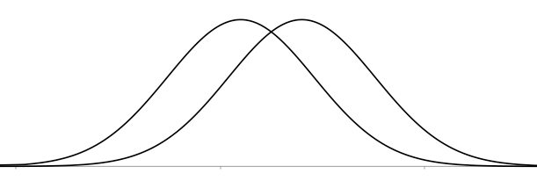
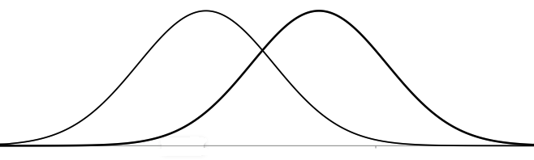
What those distributions tells us?
More overlap = harder to distinguish between signal and noise
Less overlap = easier to distinguish between signal and noise

Slide 14
d’ (d prime) as discrimination measure
d′ = Z(Hit Rate) − Z(False Alarm Rate)
Changes in d’ moves our signal distribution closer to or further form noise distribution
Probability axis
d’
Stimulus/evidence strength axis

Slide 15
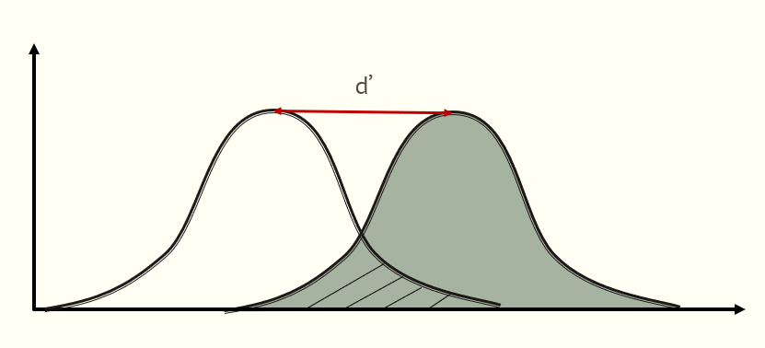
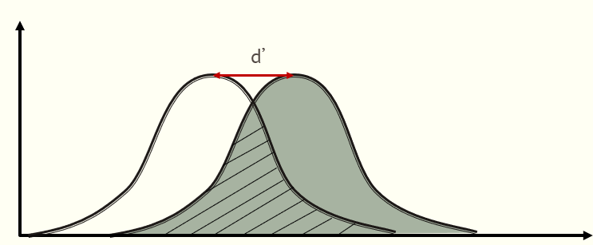
What does d’ mean?
Less overlap between noise and signal = the discrimination task is easier (signal differs a lot from noise, e.g. react if you see letter “h”, letter “x” and “c” as distractors)
More overlap between noise and signal = the discrimination task is more difficult (signal is similar to noise, e.g. react if you see letter “h”, letter “n” and “b” as distractors)
Think of d′ as the sharpness of your “mental radar” — the higher it is, the more easily you can pick out the signal from the static.

Slide 16
What those distributions tells us?
Criterion shifted to the left = more „yes” responses
But who is the ideal responder?
Where to place criterion to be neutral?
Criterion shifted to the right = fewer „yes” responses

Slide 17
Criterion and bias in SDT
As long as d’ and discriminability reflects person’s ability to distinguish signal from noise, and we assume it is fixed; criterion placement is under person’s control
Some people need more, and some need less evidence – this is their overall tendency or bias toward either responding “yes” or “no”, when they are uncertain
This bias may be induced by conditions of the task, specifically payoffs (if we earn points for hits, but don’t lose anything for false alarms, why not say “yes” all the time?)
Hypothetical person who is not biased towards neither response is called ideal responder or observer. It is treated as reference point when we want to determine someone’s bias.

Slide 18
Criterion and bias in SDT
Liberal responder:
Doesn’t need much evidence to say “yes”
Has a lot of hits, but also many false alarms
Relatively few misses and correct rejections comparing to hits and false alarms
Conservative responder:
Needs more evidence to say “yes”
Minimises false alarms, but at the expense of less hits
Less hits and false alarms compared to misses and correct rejections

Slide 19
C as the bias measure
C = −0,5 (Z HR + Z FAR)
Ideal responder: C = 0
Conservative responder: C > 0
Liberal responder: C < 0
Changing criterion placement affects proportions of hits, false alarms, misses and correct rejections
Ideal responder
But our signal and noise distributions remain the same (it doesn’t affect d’ value)
Correct rejection
Hit
Stimulus/evidence strength axis
Miss
False alarm

Slide 20
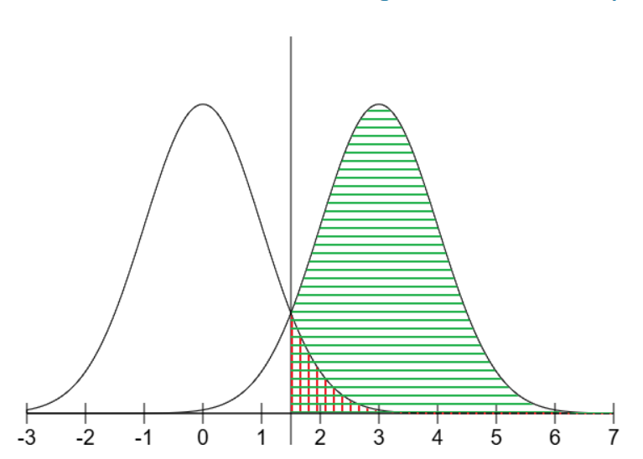
The interplay of d’ and criterion placement
What is happening when we change criterion? How does it affect HRs and FARs?
What changes in d’ are doing to HRs and FARs?
Find out yourself: Signal Detection Theory

Slide 21
Wrap-up & key takeaways
In every detection task signal and noise distributions overlap
4 SDT decision outcomes: hit, miss, false alarm, correct rejection
Degree of overlap determines difficulty of the task and/or observer’s ability to tell signal from noise
d’ measure allows us to quantify and compare this ability
Criterion placement is observer’s decision how much evidence is needed to say “yes, signal!”
C measure tell us about the degree and direction of bias (conservative or liberal)
Changing criterion placement is always a trade-off between hit rate and false alarm rate
Only by increasing d’ we can get more hits without an increase in false alarms

